Slide 1
英语教育PPT模板
汇报人：xxx 汇报时间：XX年XX月XX日

Slide 2

点击添加标题
Briefly describe the point of this lesson, which is that the class will be learning about the relationship between good nutrition and health.

Slide 3
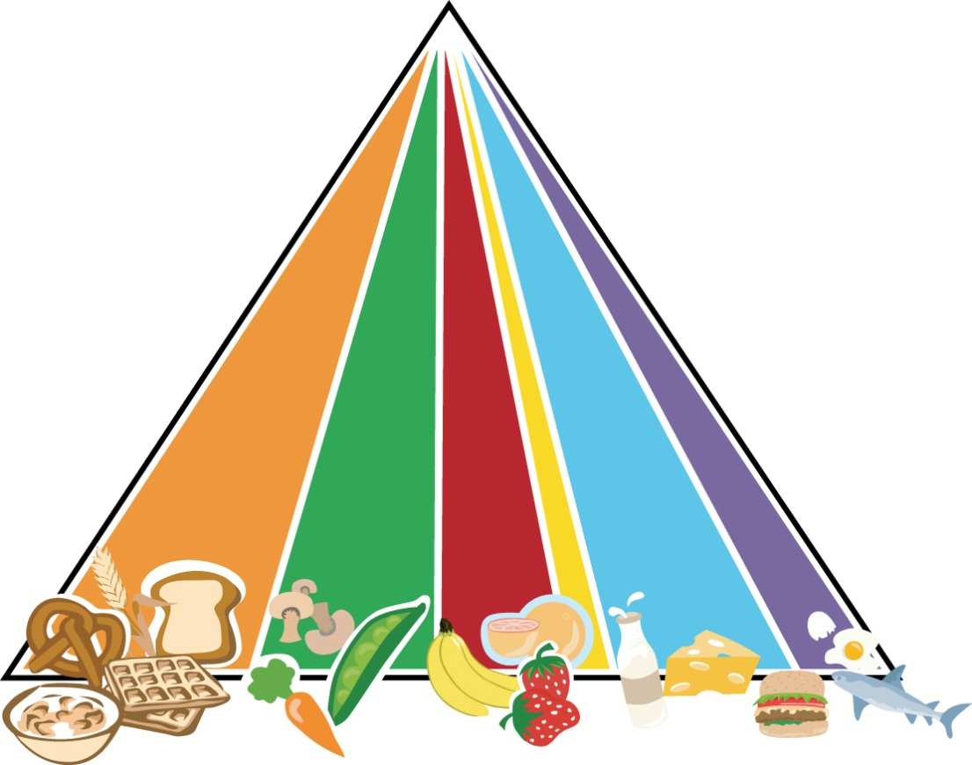
点击添加标题
Steps to a healthier you
GRAINS
VEGETABLES
FRUITS
OILS
MILK
MEAT & BEANS

Slide 4
点击添加标题
Make half of your grains whole
List a few examples of grains that are plentiful in your area.
Discuss how much children should eat every day and when they might have them.
Together, research and discuss the health benefits of grains.
Encourage children to list foods that they like from this food group.

Slide 5
点击添加标题
Vary your veggies
List a few examples of vegetables that are plentiful in your area.
Discuss how much children should eat every day and when they might have them.
Together, research and discuss the health benefits of vegetables.
Encourage children to list foods that they like from this food group.

Slide 6
点击添加标题
Focus on fruits
List a few examples of fruits that are plentiful in your area.
Discuss how much children should eat every day and when they might have them.
Together, research and discuss the health benefits of fruits.
Encourage children to list foods that they like from this food group.

Slide 7
点击添加标题
Know your fats
List a few examples of oils and fats.
Discuss how much children should eat daily and what foods contain oils and fats.
Together, research and discuss the health benefits associated with the different kinds of oils and fats.
Encourage children to list foods that they like from this food group.

Slide 8
点击添加标题
Get your calcium rich foods
List a few examples of milk products.
Discuss how much children should eat daily and when they might have them.
Together, research and discuss the health benefits of milk products.
Encourage children to list foods that they like from this food group.

Slide 9
点击添加标题
Go lean on protein
List a few examples of meat and bean products that are plentiful in your area.
Discuss how much children should eat daily and when they might have them.
Together, research and discuss the health benefits of meat and beans.
Encourage children to list foods that they like from this food group.

Slide 10
点击添加标题
Extras for luxury foods
What are discretionary calories?
Discuss how many discretionary calories children should eat every day.
Solicit class feedback for examples of ways to use discretionary calories.

Slide 11
点击添加标题
Strive for 60 minutes or more per day
What is physical activity?
Discuss moderate vs. vigorous activity.
Solicit class feedback for examples of moderate and vigorous activities.

Slide 12
谢谢观看

