Slide 1
2020
工作总结 / 工作计划 / 工作汇报
极简风工作计划
The user can demonstrate on a projector or computer, or print the presentation and make it into a film to be used in a wider field The user can demonstrate on a projector or computer
汇报人：ppt

Slide 2
CONTENTS
1
2
3
4
年度工作概述
工作完成情况
工作存在不足
明年工作计划
The user can demonstrate on a projector or computer, or print the presentation and make it into a film to be used in a wider field The user can demonstrate on a projector or computer

Slide 3
1
年度工作概述
PART 01
print the presentation and make it into a film to be used in a wider field The user can demonstrate on a projector or computer

Slide 4
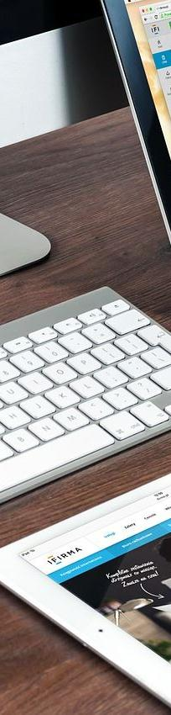
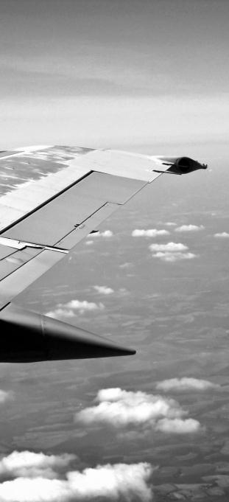
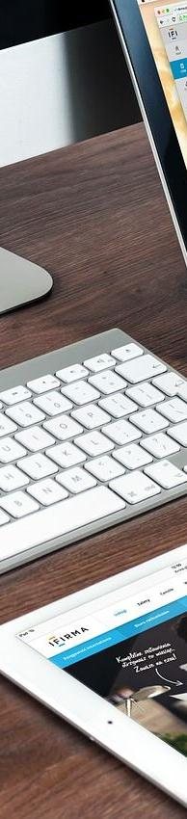


01
年度工作概述
print the presentation and make it into a film to be used in a wider field
标题文字添加
标题文字添加
The user can demonstrate on a projector or computer, or presentation and make it film to be used in a wider field
The user can demonstrate on a projector or computer, or presentation and make it film to be used in a wider field

Slide 5
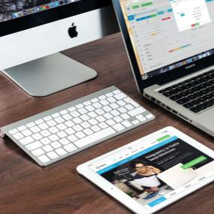
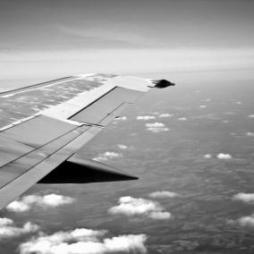

01
年度工作概述
print the presentation and make it into a film to be used in a wider field
1
2
3
标题文字添加
标题文字添加
标题文字添加
The user can demonstrate on a projector or computer, or presentation and make it film to be ua wider field
The user can demonstrate on a projector or computer, or presentation and make it film to be ua wider field
The user can demonstrate on a projector or computer, or presentation and make it film to be ua wider field

Slide 6
2
工作完成情况
PART 02
print the presentation and make it into a film to be used in a wider field The user can demonstrate on a projector or computer

Slide 7
02
工作完成情况
print the presentation and make it into a film to be used in a wider field
标题文本预设
标题文本预设
标题文本预设
标题文本预设
标题文本预设
标题文本预设
标题文本预设
标题文本预设
标题文本预设
标题文本预设
标题文本预设
标题文本预设
标题文本预设
标题文本预设
标题文本预设
标题文本预设
标题文本预设

Slide 8
02
工作完成情况
print the presentation and make it into a film to be used in a wider field
标题文字添加
标题文字添加
标题文字添加
The user can demonstrate on a projector or computer, or presentation wider field
The user can demonstrate on a projector or computer, or presentation wider field
The user can demonstrate on a projector or computer, or presentation wider field
2015
2016
2018
2018
2019
2020
标题文字添加
标题文字添加
标题文字添加
The user can demonstrate on a projector or computer, or presentation wider field
The user can demonstrate on a projector or computer, or presentation wider field
The user can demonstrate on a projector or computer, or presentation wider field

Slide 9
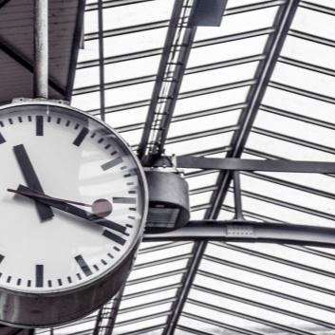
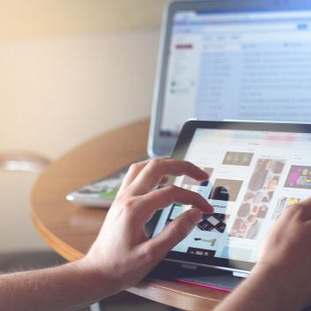
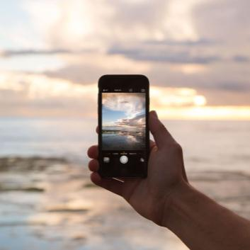

02
工作完成情况
print the presentation and make it into a film to be used in a wider field
标题文字添加
标题文字添加
标题文字添加
标题文字添加
presentation and make it film to be a wider field
presentation and make it film to be a wider field
presentation and make it film to be a wider field
presentation and make it film to be a wider field

Slide 10
02
工作完成情况
print the presentation and make it into a film to be used in a wider field
标题文字添加
标题文字添加
The user can demonstrate on a projector or computer, ilm to be used in a wider field
The user can demonstrate on a projector or computer, ilm to be used in a wider field
标题文字添加
标题文字添加
标题文字添加
The user can demonstrate on a projector or computer, ilm to be used in a wider field
The user can demonstrate on a projector or computer, ilm to be used in a wider field
The user can demonstrate on a projector or computer, ilm to be used in a wider field

Slide 11
3
工作存在不足
PART 03
print the presentation and make it into a film to be used in a wider field The user can demonstrate on a projector or computer

Slide 12
03
工作存在不足
print the presentation and make it into a film to be used in a wider field
标题文字添加
The user can demonstrate on a projector or computer, or presentation and make it film to be used in a wider field
标题文字添加
The user can demonstrate on a projector or computer, or presentation and make it film to be used in a wider field
标题文字添加
The user can demonstrate on a projector or computer, or presentation and make it film to be used in a wider field
标题文字添加
The user can demonstrate on a projector or computer, or presentation and make it film to be used in a wider field

Slide 13
03
工作存在不足
print the presentation and make it into a film to be used in a wider field
125,000
150,000
180,000
The user can demonstrate on a projector or computer, or presentation and make it film to be used in a wider field
The user can demonstrate on a projector or computer, or presentation and make it film to be used in a wider field
The user can demonstrate on a projector or computer, or presentation and make it film to be used in a wider field
标题文本预设
标题文本预设
标题文本预设

Slide 14
4
明年工作计划
PART 04
print the presentation and make it into a film to be used in a wider field The user can demonstrate on a projector or computer

Slide 15
04
明年工作计划
print the presentation and make it into a film to be used in a wider field
标题文字添加
标题文字添加
标题文字添加
标题文字添加
标题文字添加
The user can demonstrate on a projector or computer
The user can demonstrate on a projector or computer
The user can demonstrate on a projector or computer
The user can demonstrate on a projector or computer
The user can demonstrate on a projector or computer

Slide 16
2020
工作总结 / 工作计划 / 工作汇报
感谢您的观看
The user can demonstrate on a projector or computer, or print the presentation and make it into a film to be used in a wider field The user can demonstrate on a projector or computer
汇报人：ppt

