Slide 1

快递公司年终总结ppt模板

Slide 2

PART.01 The Road to Success
To summarize what I have said: aim for the highest; never enter a bar room; do not touch liquor, or if at all only at meals; never speculate; never indorse beyond your surplus cash fund;
Andy Carle
PART.02 The Road to Success
To summarize what I have said: aim for the highest; never enter a bar room; do not touch liquor, or if at all only at meals;
To summarize what I have said: aim for the highest; never enter a bar room; do not touch liquor, or if at all only at meals; never speculate; never indorse beyond your surplus cash fund;
PART.03 The Road to Success
To summarize what I have said: aim for the highest; never enter a bar room; do not touch liquor, or if at all only at meals; never speculate; never indorse beyond your surplus cash fund;

Slide 3

PART.01
To summarize what I have said: aim for the highest; never enter a bar room; do not touch liquor, or if at all only at meals; never speculate; never indorse beyond your surplus cash fund;
The Road to Success

Slide 4



Simple Title Here
The Goodness of life
The Goodness of life
Focused on
Even when the cold winds blow and the world seems to becovered in foggy shadows, the goodness of life lives on. Open your eyes, open your heart, and you will see that goodness is everywhere.

Slide 5


Simple Title Here
The Goodness of life
The Road to Success
Even when the cold winds blow and the world seems to becovered in foggy shadows, the goodness of life lives on. Open your eyes, open your heart, and you will see that goodness is everywhere.

Slide 6




Simple Title Here
The Goodness of life
The Road to Success
The Road to Success
Even when the cold winds blow and the world seems to becovered in foggy shadows, the goodness of life lives on. Open your eyes, open your heart, and you will see that goodness is everywhere.
Even when the cold winds blow and the world seems to becovered in foggy shadows, the goodness of life lives on. Open your eyes, open your heart, and you will see that goodness is everywhere.
The Road to Success
The Road to Success
Even when the cold winds blow and the world seems to becovered in foggy shadows, the goodness of life lives on. Open your eyes, open your heart, and you will see that goodness is everywhere.
Even when the cold winds blow and the world seems to becovered in foggy shadows, the goodness of life lives on. Open your eyes, open your heart, and you will see that goodness is everywhere.

Slide 7







Simple Title Here
The Goodness of life
Camera
Message
Address
Voice
The applause rose to a crescendo and cameras clicked
Officials failed to passvital information to their superiors
Officials failed to passvital information to their superiors
thoughta phonetic spelling might aid in pronunciation

Slide 8

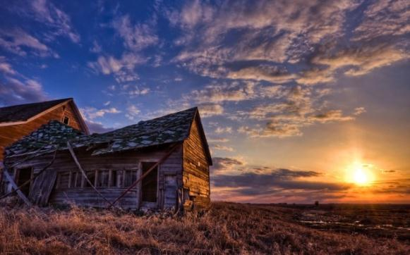


Simple Title Here
The Goodness of life
The Goodness of life
Even when the cold winds blow and the world seems to becovered in foggy shadows, the goodness of life lives on. Open your eyes, open your heart, and you will see that goodness is everywhere.
01
02
03

Slide 9
Simple Title Here
The Goodness of life
☒


Simple Title Here
Simple Title Here
Simple Title Here
Even when the cold winds blow and the world seems to becovered in foggy shadows,
Even when the cold winds blow and the world seems to becovered in foggy shadows,
Even when the cold winds blow and the world seems to becovered in foggy shadows,



Simple Title Here
Simple Title Here
Simple Title Here
Even when the cold winds blow and the world seems to becovered in foggy shadows,
Even when the cold winds blow and the world seems to becovered in foggy shadows,
Even when the cold winds blow and the world seems to becovered in foggy shadows,

Slide 10
Simple Title Here
The Goodness of life
Simple Title Here
Even when the cold winds blow and the world seems to becovered
Simple Title Here
Even when the cold winds blow and the world seems to becovered
Simple Title Here
Even when the cold winds blow and the world seems to becovered
Simple Title Here
Even when the cold winds blow and the world seems to becovered

Slide 11
Simple Title Here
The Goodness of life
82%
63%
91%
Simple Title Here
Simple Title Here
Simple Title Here
Even when the cold winds blow and the world seems to becovered
Even when the cold winds blow and the world seems to becovered
Even when the cold winds blow and the world seems to becovered

Slide 12
Simple Title Here
The Goodness of life
65%
73%
Simple Title Here
Simple Title Here
Even when the cold winds blow and the world seems
Even when the cold winds blow and the world seems
☒81%
67%
Simple Title Here
Simple Title Here
Even when the cold winds blow and the world seems
Even when the cold winds blow and the world seems

Slide 13
Simple Title Here
The Goodness of life
Simple Title Here
Even when the cold winds blow and the world seems to become ,in foggy shadows,
35% Simple Title Here
Even when the cold win blow and the world seems
62% Simple Title Here
Even when the cold win blow and the world seems

Slide 14
Simple Title Here
The Goodness of life
Simple Title Here
Even when the cold winds blow and the world seems to become ,in foggy shadows,
Even when the cold winds blow and the world seems to become ,in foggy shadows
ShanDong
GuangZhou
Even when the cold winds blow and the world seems to
Even when the cold winds blow and the world seems to
ShanXi
GanSu
Even when the cold winds blow and the world seems to
Even when the cold winds blow and the world seems to

Slide 15
Thanks
The PowerPoint is extremely beautiful,
we focus on will be able to admire works of art into PPT

