Slide 1
2030
软件项目技术方案ppt模板
The user can demonstrate on a projector or computer, or print the presentation and make it into a film to be used in a wider field

Slide 2
目录
CONTENTS
1
年终工作概述
2
工作完成情况
3
存在不足之处
4
下步工作计划

Slide 3


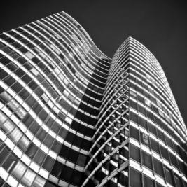

年终总结概述
The user can demonstrate on a projector or computer, or print the presentation and make it into a film to be used in a wider field

Slide 4
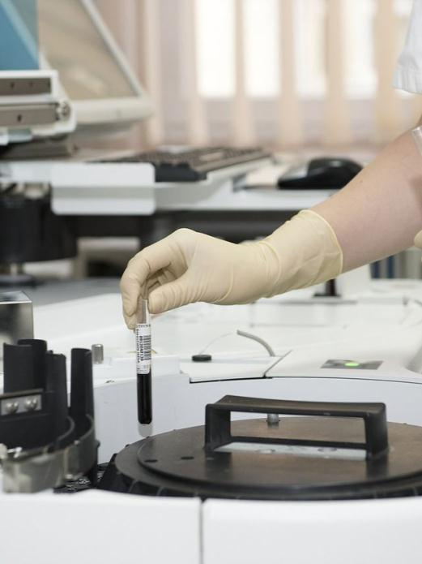


年终工作概述
标题文字添加
The user can demonstrate on a projector or computer, or print the presentation and make it into a film to be used in a wider field. Using PowerPoint,
标题文字添加
The user can demonstrate on a projector or computer, or print the presentation and make it into a film to be used in a wider field. Using PowerPoint,

Slide 5

年终工作概述
标题文字添加
标题文字添加
The user can demonstrate on a projector or computer, or presentation and make it film to be used in a wider field
The user can demonstrate on a projector or computer, or presentation and make it film to be used in a wider field
标题文字添加
标题文字添加
The user can demonstrate on a projector or computer, or presentation and make it film to be used in a wider field
The user can demonstrate on a projector or computer, or presentation and make it film to be used in a wider field
标题文字添加
标题文字添加
The user can demonstrate on a projector or computer, or presentation and make it film to be used in a wider field
The user can demonstrate on a projector or computer, or presentation and make it film to be used in a wider field

Slide 6
年终工作概述
The user can demonstrate on a projector or computer, or print the presentation and make it into a film to be used in a wider field. Using PowerPoint,
标题文字添加
标题文字添加
标题文字添加
The user can demonstrate on a projector or computer, or print the presentation and make it into a film to be used in a wider field. Using PowerPoint,
The user can demonstrate on a projector or computer, or print the presentation and make it into a film to be used in a wider field. Using PowerPoint,
The user can demonstrate on a projector or computer, or print the presentation and make it into a film to be used in a wider field. Using PowerPoint,

Slide 7
年终工作概述
标题文字添加
标题文字添加
The user can demonstrate on a projector or computer, or presentation and make it film to be used in a wider field
The user can demonstrate on a projector or computer, or presentation and make it film to be used in a wider field
e
x
t
S
a
m
l
e
T
p
l
e
m
p
T
e
S
a
x
t
t
x
a
S
e
T
p
m
e
l
p
T
e
l
标题文字添加
m
a
S
t
x
e
标题文字添加
The user can demonstrate on a projector or computer, or presentation and make it film to be used in a wider field
The user can demonstrate on a projector or computer, or presentation and make it film to be used in a wider field

Slide 8
年终工作概述
key words
key words
标题文字添加
标题文字添加
The user can demonstrate on a projector or computer, or presentation and make it film to be used in a wider field
key words
The user can demonstrate on a projector or computer, or presentation and make it film to be used in a wider field
key words
标题文字添加
标题文字添加
The user can demonstrate on a projector or computer, or presentation and make it film to be used in a wider field
2030
PROJECT
The user can demonstrate on a projector or computer, or presentation and make it film to be used in a wider field
PLAN

Slide 9
工作完成情况
The user can demonstrate on a projector or computer, or print the presentation and make it into a film to be used in a wider field

Slide 10

工作完成情况
40%
25%
15%
10%
10%
标题文字添加
The user can demonstrate on a projector or computer, or presentation and make it film to be used in a wider field
标题文字添加
The user can demonstrate on a projector or computer, or presentation and make it film to be used in a wider field
标题文字添加
The user can demonstrate on a projector or computer, or presentation and make it film to be used in a wider field
标题文字添加
The user can demonstrate on a projector or computer, or presentation and make it film to be used in a wider field

Slide 11
工作完成情况
05
标题文字添加
标题文字添加
The user can demonstrate on a projector or computer, or presentation and make it film to be used in a wider field
The user can demonstrate on a projector or computer, or presentation and make it film to be used in a wider field
04
03
标题文字添加
标题文字添加
The user can demonstrate on a projector or computer, or presentation and make it film to be used in a wider field
The user can demonstrate on a projector or computer, or presentation and make it film to be used in a wider field
01
02
标题文字添加
The user can demonstrate on a projector or computer, or presentation and make it film to be used in a wider field

Slide 12
工作完成情况
文字添加
文字添加
文字添加
文字添加
The user can demonstrate on a projector or computer, or presentation and make it film to be used in a wider field
The user can demonstrate on a projector or computer, or presentation and make it film to be used in a wider field
The user can demonstrate on a projector or computer, or presentation and make it film to be used in a wider field
The user can demonstrate on a projector or computer, or presentation and make it film to be used in a wider field

Slide 13

工作完成情况
标题文字添加
标题文字添加
The user can demonstrate on a projector or computer, or print the presentation and make it into a film to be used in a wider field
The user can demonstrate on a projector or computer, or print the presentation and make it into a film to be used in a wider field
标题文字添加
标题文字添加
The user can demonstrate on a projector or computer, or print the presentation and make it into a film to be used in a wider field
The user can demonstrate on a projector or computer, or print the presentation and make it into a film to be used in a wider field

Slide 14
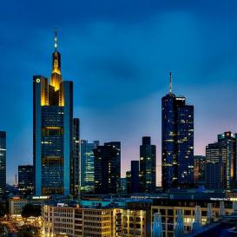
工作完成情况
标题文字添加
标题文字添加
The user can demonstrate on a projector or computer, or print the presentation and make it into a film to be used in a wider field. Using PowerPoint,
The user can demonstrate on a projector or computer, or print the presentation and make it into a film to be used in a wider field. Using PowerPoint,
标题文字添加
The user can demonstrate on a projector or computer, or print the presentation and make it into a film to be used in a wider field. Using PowerPoint,

Slide 15
存在不足之处
The user can demonstrate on a projector or computer, or print the presentation and make it into a film to be used in a wider field

Slide 16

存在不足之处
标题文字添加
标题文字添加
标题文字添加
The user can demonstrate on a projector or computer, or print the presentation and make it into a film to be used in a wider field. Using PowerPoint,
The user can demonstrate on a projector or computer, or print the presentation and make it into a film to be used in a wider field. Using PowerPoint,
The user can demonstrate on a projector or computer, or print the presentation and make it into a film to be used in a wider field. Using PowerPoint,
标题文字添加
标题文字添加
The user can demonstrate on a projector or computer, or print the presentation and make it into a film to be used in a wider field. Using PowerPoint,
The user can demonstrate on a projector or computer, or print the presentation and make it into a film to be used in a wider field. Using PowerPoint,

Slide 17
存在不足之处
标题文字添加
The user can demonstrate on a projector or computer, or print the presentation and make it into a film to be used in a wider field. Using PowerPoint,
标题文字添加
The user can demonstrate on a projector or computer, or print the presentation and make it into a film to be used in a wider field. Using PowerPoint,
标题文字添加
The user can demonstrate on a projector or computer, or print the presentation and make it into a film to be used in a wider field. Using PowerPoint,
标题文字添加
The user can demonstrate on a projector or computer, or print the presentation and make it into a film to be used in a wider field. Using PowerPoint,

Slide 18
存在不足之处
标题文字添加
标题文字添加
The user can demonstrate on a projector or computer, or print the presentation and make it into a film to be used in a wider field. Using PowerPoint,
The user can demonstrate on a projector or computer, or print the presentation and make it into a film to be used in a wider field. Using PowerPoint,
标题文字添加
标题文字添加
The user can demonstrate on a projector or computer, or print the presentation and make it into a film to be used in a wider field. Using PowerPoint,
The user can demonstrate on a projector or computer, or print the presentation and make it into a film to be used in a wider field. Using PowerPoint,

Slide 19
存在不足之处
The user can demonstrate on a projector
The user can demonstrate on a projector
The user can demonstrate on a projector
2014
2016
2020
2015
2019
2030
The user can demonstrate on a projector
The user can demonstrate on a projector
The user can demonstrate on a projector
标题文字添加此处
The user can demonstrate on a projector or computer, or print the presentation and make it into a film to be used in a wider fieldThe user can demonstrate on a projector or computer, or print the to be used in a wider field

Slide 20
下步工作计划
The user can demonstrate on a projector or computer, or print the presentation and make it into a film to be used in a wider field

Slide 21
下步工作计划
标题文字添加此处
The user can demonstrate on a projector or computer, or print the presentation and make it into a film to be used in a wider field
标题文字添加此处
标题文字添加此处
or print the presentation and make it into a film to be used in a wider field
or print the presentation and make it into a film to be used in a wider field
标题文字添加此处
标题文字添加此处
or print the presentation and make it into a film to be used in a wider field
or print the presentation and make it into a film to be used in a wider field

Slide 22
下步工作计划
标题文字添加
标题文字添加
标题文字添加
标题文字添加
The user can demonstrate on a projector or computer, or presentation and make it film to be used in a wider field
The user can demonstrate on a projector or computer, or presentation and make it film to be used in a wider field
The user can demonstrate on a projector or computer, or presentation and make it film to be used in a wider field
The user can demonstrate on a projector or computer, or presentation and make it film to be used in a wider field

Slide 23
下步工作计划
标题文字添加
标题文字添加
标题文字添加
标题文字添加
The user can demonstrate on a projector or computer, or print the presentation and make it into a film to be used in a wider field. Using PowerPoint,
The user can demonstrate on a projector or computer, or print the presentation and make it into a film to be used in a wider field. Using PowerPoint,
The user can demonstrate on a projector or computer, or print the presentation and make it into a film to be used in a wider field. Using PowerPoint,
The user can demonstrate on a projector or computer, or print the presentation and make it into a film to be used in a wider field. Using PowerPoint,

Slide 24
下步工作计划
标题文字添加
The user can demonstrate on a projector or computer, or presentation and make it film to be used in a wider field
标题文字添加
The user can demonstrate on a projector or computer, or presentation and make it film to be used in a wider field
标题文字添加
The user can demonstrate on a projector or computer, or presentation and make it film to be used in a wider field
标题文字添加
The user can demonstrate on a projector or computer, or presentation and make it film to be used in a wider field

Slide 25
2030
演示完毕感谢观看
The user can demonstrate on a projector or computer, or print the presentation and make it into a film to be used in a wider field

