Slide 1

ART TEMPLATE
涂鸦活动方案ppt模板
THIS IS A ART TEMPLATE , THANK YOU WATCHING THIS ONE. THIS IS A ART TEMPLATE , THANK YOU WATCHING THIS ONE.

Slide 2

CONTENT
01
02
03
04
ADD TITTLE HERE
ADD TITTLE HERE
ADD TITTLE HERE
ADD TITTLE HERE

Slide 3
第一部分
THIS IS A ART TEMPLATE , THANK YOU WATCHING THIS ONE. THIS IS A ART TEMPLATE ,

Slide 4

点击即可添加标题
I will do somebody a good turnJust for today I will try to live through this day only and not tackle my whole three ways. I will do somebody a good turnJust for today I will try to live through this day only and not tackle my whole
点击即可添加标题
Just for today I will exercise my soul in three ways. I will do somebody a good turn and not get found out: If anybody knows of it,
点击即可添加标题
Just for today I will exercise my soul in three ways. I will do somebody a good turn and not get found out: If anybody knows of it,

Slide 5


ADD TITTLE HERE
Just for today I will try to live through this day only and not tackle my whole life problem at once. I can do for twelve Just for today I will try to live through this day only and not tackle my whole life problem at once. I can do for twelve Just for today I will try to live through this day only and not tackle my whole life problem at once. I can do for twelve

Slide 6
Just for today I will try to live through this day only and not tackle my whole life problem at once
点击即可添加标题
0 1
Just for today I will try to live through this day only and not tackle my whole life problem at once
0 2
点击即可添加标题
Just for today I will try to live through this day only and not tackle my whole life problem at once
0 3
点击即可添加标题

Slide 7


Just for today I will try to live through this day only and not tackle my whole life problem at once. only and not tackle my whole life problem at once.
Just for today I will try to live through this day only and not tackle my whole life problem at once. only and not tackle my whole life problem at once.

Slide 8
ADD TITTLE
ADD TITTLE
60%
Just for today I will try to live through this day only and not tackle my whole life problem at once.
55%
Just for today I will try to live through this day only and not tackle my whole life problem at once.
ADD TITTLE
ADD TITTLE
80%
Just for today I will try to live through this day only and not tackle my whole life problem at once.
60%
Just for today I will try to live through this day only and not tackle my whole life problem at once.

Slide 9
第二部分
THIS IS A ART TEMPLATE , THANK YOU WATCHING THIS ONE. THIS IS A ART TEMPLATE ,

Slide 10

点击即可添加标题
Just for today I will try to live through this day only and not tackle my whole life problem at once. Just for today I will try to live through this day only and not tackle my whole life problem at once.
Just for today I will try to live through this day only and not tackle my whole life problem at once Just for
Just for today I will try to live through this day only and not tackle my whole life problem at once Just for

Slide 11


Just for today I will try to live through this day only and not tackle my whole life problem at once.
Just for today I will try to live through this day only and not tackle my whole life problem at once.

Slide 12
点击即可添加标题
Just for today I will try to live through this day only and not tackle my whole life problem at once Just for today I will try to live through this day only and not tackle my whole life problem at once
ADD TITTLE HERE
ADD TITTLE HERE
ADD TITTLE HERE
Just for today I will try to live through this day only and not tackle my whole life
Just for today I will try to live through this day only and not tackle my whole life
Just for today I will try to live through this day only and not tackle my whole life

Slide 13


点击即可添加标题
点击即可添加标题
Just for today I will try to live through this day only and not tackle my whole life problem at once Just for today
Just for today I will try to live through this day only and not tackle my whole life problem at once Just for today

Slide 14
点 击 即 可 添 加 标 题
Just for today I will try to live through this day only and not tackle my whole life problem at once Just for today I will try to live through this day only and not tackle my whole life problem at once. tackle my whole life problem at once Just for today I will try to live through this day
Just for today I will try to live through this day only and not tackle my whole life problem at once I will try to live through this day only and not tackle my
Just for today I will try to live through this day only and not tackle my whole life problem at once I will try to live through this day only and not tackle my
Just for today I will try to live through this day only and not tackle my whole life problem at once I will try to live through this day only and not tackle my

Slide 15
第三部分
THIS IS A ART TEMPLATE , THANK YOU WATCHING THIS ONE. THIS IS A ART TEMPLATE ,

Slide 16
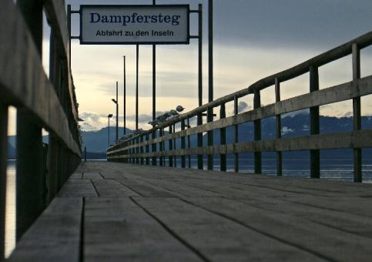

点击即可添加标题
hours that Just for today I will try to live through this day only and not tackle my whole life problem at once. I can do for
点击即可添加标题
hours that Just for today I will try to live through this day only and not tackle my whole life problem at once. I can do for

Slide 17

点 击 即 可 添 加 标 题
Just for today I will try to live through this day only and not tackle my whole life problem at once Just for today I will try to live through this
0 1
Just for today I will try to live through this day only and not tackle my whole life problem at once
0 2
Just for today I will try to live through this day only and not tackle my whole life problem at once
0 3
Just for today I will try to live through this day only and not tackle my whole life problem at once

Slide 18



Just for today I will try to live through this day only and not tackle my whole life problem at once. only and not tackle my whole life problem at once. Just for today I will try to live through
Just for today I will try to live through this day only and not tackle my whole life problem at once. only and not tackle my whole life problem at once. Just for today I will try to live through
Just for today I will try to live through this day only and not tackle my whole life problem at once. only and not tackle my whole life problem at once. Just for today I will try to live through

Slide 19
1
点 击 即 可 添 加 标 题
2
点 击 即 可 添 加 标 题
Just for today I will try to live through this day only and not tackle my whole
Just for today I will try to live through this day only and not tackle my whole
3
点 击 即 可 添 加 标 题
4
点 击 即 可 添 加 标 题
Just for today I will try to live through this day only and not tackle my whole
Just for today I will try to live through this day only and not tackle my whole

Slide 20
第四部分
THIS IS A ART TEMPLATE , THANK YOU WATCHING THIS ONE. THIS IS A ART TEMPLATE ,

Slide 21

点 击 即 可 添 加 标 题
Just for today I will try to live through this day only and not tackle my whole life problem at once Just for today I will try to live through this day only and not tackle my whole life problem at once Just for only
Just for today I will try to live through this day only and not tackle my whole life problem at once Just for today I will try to live through this day only and not tackle my whole life problem at once Just for only

Slide 22
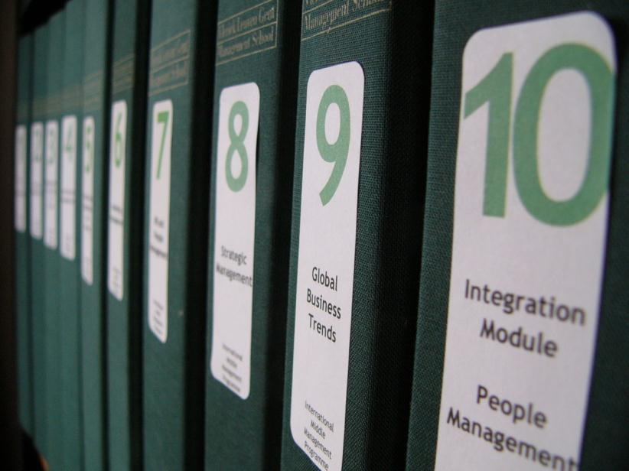
THIS IS A ART TEMPLATE ,THANK YOU WATCHING THIS ONE
Just for today I will try to live through this day only and not tackle my whole life problem at once. I can do for twelve hours that
Just for today I will try to live through this day only and not tackle my whole life problem at once. I can do for twelve hours that hours that Just for today I will try to live through this day only and not tackle my

Slide 23
点 击 即 可 添 加 标 题
点 击 即 可 添 加 标 题
1
Just for today I will try to live through this day only and not tackle my
3
Just for today I will try to live through this day only and not tackle my
2
4
点 击 即 可 添 加 标 题
点 击 即 可 添 加 标 题
Just for today I will try to live through this day only and not tackle my
Just for today I will try to live through this day only and not tackle my

Slide 24
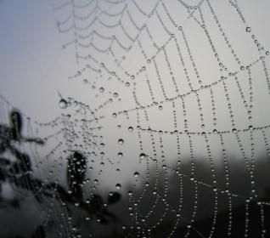


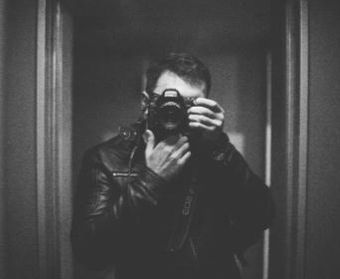
点 击 即 可 添 加 标 题
Just for today I will try to live through this day only and not tackle my whole life problem at once. I can
0 1
Just for today I will try to live through this day only and not tackle my whole life problem at once
0 2
Just for today I will try to live through this day only and not tackle my whole life problem at once
0 3
Just for today I will try to live through this day only and not tackle my whole life problem at once

Slide 25
ART TEMPLATE
感 谢 您 的 观 看
THIS IS A ART TEMPLATE , THANK YOU WATCHING THIS ONE. THIS IS A ART TEMPLATE , THANK YOU WATCHING THIS ONE.

