Slide 1

工作总结
商务汇报
述职报告
商务规划
亲子阅读活动策划方案ppt模板
20XX
The user can demonstrate on a projector or computer, or print the presentation and make it into a film to be used in a wider field The user can demonstrate
汇报人：第一PPT

Slide 2

01 . 年度工作概述
print the presentation and make it into a film a wider field
CONTENT
02 . 工作完成情况
print the presentation and make it into a film a wider field
03 . 工作存在不足
print the presentation and make it into a film a wider field
04 . 明年工作计划
print the presentation and make it into a film a wider field

Slide 3
01
年度工作概述
print the presentation and make it into a film to be used in a wider field The user can demonstrate on a projector or computer

Slide 4

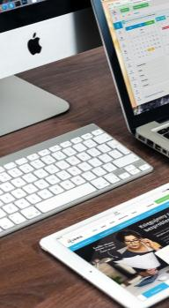



01
年度工作概述
print the presentation and make it into a film to be used in a wider
01
02
03
04
标题文字添加
标题文字添加
标题文字添加
标题文字添加
The user can demonstrate on a projector or computer, or presentation and make it film to be used in a wider field
The user can demonstrate on a projector or computer, or presentation and make it film to be used in a wider field
The user can demonstrate on a projector or computer, or presentation and make it film to be used in a wider field
The user can demonstrate on a projector or computer, or presentation and make it film to be used in a wider field

Slide 5


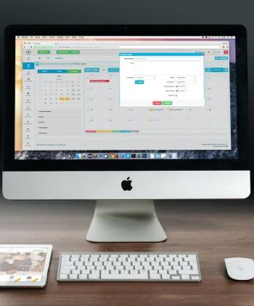

01
年度工作概述
print the presentation and make it into a film to be used in a wider
标题文字添加
标题文字添加
标题文字添加
标题文字添加
The user can demonstrate on a projector or computer, or presentation and make it film to be used in a wider field
The user can demonstrate on a projector or computer, or presentation and make it film to be used in a wider field
The user can demonstrate on a projector or computer, or presentation and make it film to be used in a wider field
The user can demonstrate on a projector or computer, or presentation and make it film to be used in a wider field

Slide 6



01
年度工作概述
print the presentation and make it into a film to be used in a wider
The user can demonstrate on a projector or computer, orThe user can demonstrate on a projector or computer, or print the presentation and make it into a film printThe user can demonstrate on a projector or computer, or print the presentation and make it into a film theThe user
标题文字添加
标题文字添加
标题文字添加
The user can demonstrate on a projector or computer, or presentation and make it film to be used in a wider field
The user can demonstrate on a projector or computer, or presentation and make it film to be used in a wider field
The user can demonstrate on a projector or computer, or presentation and make it film to be used in a wider field

Slide 7

01
年度工作概述
print the presentation and make it into a film to be used in a wider
标题文字添加
标题文本预设
标题文本预设
标题文字添加
The user can demonstrate on a projector or computer, or presentation and make it film to be used in a wider field
The user can demonstrate on a projector or computer, or presentation and make it film to be used in a wider field
标题文字添加
标题文字添加
The user can demonstrate on a projector or computer, or presentation and make it film to be used in a wider field
The user can demonstrate on a projector or computer, or presentation and make it film to be used in a wider field
标题文本预设
标题文本预设

Slide 8
01
年度工作概述
print the presentation and make it into a film to be used in a wider
The user can demonstrate on a projector or computer, or presentation and make it film to be used in a wider field
The user can demonstrate on a projector or computer, or presentation and make it film to be used in a wider field
标题文本预设
标题文本预设
标题文本预设
The user can demonstrate on a projector or computer, or presentation and make it film to be used in a wider field
The user can demonstrate on a projector or computer, or presentation and make it film to be used in a wider field
The user can demonstrate on a projector or computer, or presentation and make it film to be used in a wider field
标题文本预设
标题文本预设

Slide 9
02
工作完成情况
print the presentation and make it into a film to be used in a wider field The user can demonstrate on a projector or computer

Slide 10
02
工作完成情况
print the presentation and make it into a film to be used in a wider
The user can demonstrate on a projector or computer, orThe user can demonstrate on a projector or computer, or print the presentation and make it into a film printThe user can demonstrate on a projector or computer, or print the presentation and make it into a film theThe user
关键词
The user can demonstrate on a projector or computer, or presentation and make it film to be used in a wider field
关键词
The user can demonstrate on a projector or computer, or presentation and make it film to be used in a wider field
关键词
The user can demonstrate on a projector or computer, or presentation and make it film to be used in a wider field

Slide 11



02
工作完成情况
print the presentation and make it into a film to be used in a wider
标题文字添加
标题文字添加
标题文字添加
The user can demonstrate on a projector or computer, or presentation and make it film to be used in a wider field
The user can demonstrate on a projector or computer, or presentation and make it film to be used in a wider field
The user can demonstrate on a projector or computer, or presentation and make it film to be used in a wider field

Slide 12
02
工作完成情况
print the presentation and make it into a film to be used in a wider
标题文字添加
The user can demonstrate on a projector or computer, or presentation and make it film to be used in a wider field
标题文字添加
The user can demonstrate on a projector or computer, or presentation and make it film to be used in a wider field
标题文字添加
The user can demonstrate on a projector or computer, or presentation and make it film to be used in a wider field

Slide 13
02
工作完成情况
print the presentation and make it into a film to be used in a wider
标题文字添加
标题文字添加
The user can demonstrate on a projector or computer, or presentation and make it film to be used in a wider field
The user can demonstrate on a projector or computer, or presentation and make it film to be used in a wider field
标题文字添加
标题文字添加
The user can demonstrate on a projector or computer, or presentation and make it film to be used in a wider field
The user can demonstrate on a projector or computer, or presentation and make it film to be used in a wider field

Slide 14
02
工作完成情况
print the presentation and make it into a film to be used in a wider
标题文字添加
标题文字添加
01
04
The user can demonstrate on a projector or computer, or presentation and make it film to be used in a wider field
The user can demonstrate on a projector or computer, or presentation and make it film to be used in a wider field
标题文字添加
标题文字添加
02
05
The user can demonstrate on a projector or computer, or presentation and make it film to be used in a wider field
The user can demonstrate on a projector or computer, or presentation and make it film to be used in a wider field
标题文字添加
标题文字添加
03
06
The user can demonstrate on a projector or computer, or presentation and make it film to be used in a wider field
The user can demonstrate on a projector or computer, or presentation and make it film to be used in a wider field

Slide 15
03
工作存在不足
print the presentation and make it into a film to be used in a wider field The user can demonstrate on a projector or computer

Slide 16
03
工作存在不足
print the presentation and make it into a film to be used in a wider
标题文字添加
The user can demonstrate on a projector or computer, or presentation and make it film to be used in a wider field
标题文字添加
标题文字添加
The user can demonstrate on a projector or computer, or presentation and make it film to be used in a wider field
The user can demonstrate on a projector or computer, or presentation and make it film to be used in a wider field

Slide 17
03
工作存在不足
print the presentation and make it into a film to be used in a wider
文字添加
标题文字添加
文字添加
The user can demonstrate on a projector or computer, orThe user can demonstrate on a projector or computer, or print the presentation and make it into a film printThe user can demonstrate on a projector or computer, or print the presentation and make it into a film theThe user can demonstrate on a projector or computer
The user can demonstrate on a projector or computer, orThe user can demonstrate on a projector or computer, or print the presentation and make it into a film printThe user can demonstrate on a projector or computer, or print the presentation and make it into a film theThe user can demonstrate on a projector or computer
文字添加
文字添加
文字添加

Slide 18





03
工作存在不足
print the presentation and make it into a film to be used in a wider
The user can demonstrate on a projector or computer, or presentation and make it film to be used in a wider field
The user can demonstrate on a projector or computer, or presentation and make it film to be used in a wider field
The user can demonstrate on a projector or computer, or presentation and make it film to be used in a wider field
The user can demonstrate on a projector or computer, or presentation and make it film to be used in a wider field
The user can demonstrate on a projector or computer, or presentation and make it film to be used in a wider field

Slide 19
03
工作存在不足
print the presentation and make it into a film to be used in a wider
The user can demonstrate on a projector or computer, orThe user can demonstrate on a projector or computer, or print the presentation and make it into a film printThe user can demonstrate on a projector or computer, or print the presentation and make it into a film theThe user
01
02
03
04
关键词
关键词
关键词
关键词
标题文字添加
标题文字添加
标题文字添加
标题文字添加
The user can demonstrate on a projector or computer, or presnd make it film
The user can demonstrate on a projector or computer, or presnd make it film
The user can demonstrate on a projector or computer, or presnd make it film
The user can demonstrate on a projector or computer, or presnd make it film

Slide 20
04
明年工作计划
print the presentation and make it into a film to be used in a wider field The user can demonstrate on a projector or computer

Slide 21
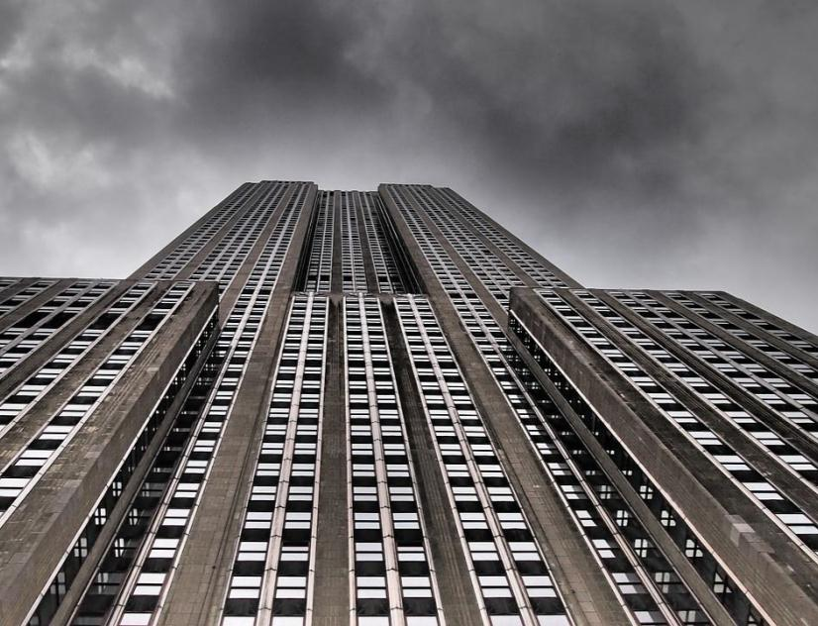
04
明年工作计划
print the presentation and make it into a film to be used in a wider
标题文字添加
The user can demonstrate on a projector or computer, or presentation and make it film to be used in a wider field
标题文字添加
The user can demonstrate on a projector or computer, or presentation and make it film to be used in a wider field
标题文字添加
The user can demonstrate on a projector or computer, or presentation and make it film to be used in a wider field

Slide 22
04
明年工作计划
print the presentation and make it into a film to be used in a wider
The user can demonstrate on a projector or computer, or presentation and make it film to be used in a wider field
标题文本预设
The user can demonstrate on a projector or computer, or presentation and make it film to be used in a wider field
标题文本预设
标题文本预设
The user can demonstrate on a projector or computer, or presentation and make it film to be used in a wider field
标题文本预设
标题文本预设
The user can demonstrate on a projector or computer, or presentation and make it film to be used in a wider field

Slide 23
04
明年工作计划
print the presentation and make it into a film to be used in a wider
65%
40%
90%
10%
标题文字添加
标题文字添加
The user can demonstrate on a projector or computer, or presentation and make it film to be used in a wider field
The user can demonstrate on a projector or computer, or presentation and make it film to be used in a wider field
45%
55%
45%
55%
标题文字添加
标题文字添加
The user can demonstrate on a projector or computer, or presentation and make it film to be used in a wider field
The user can demonstrate on a projector or computer, or presentation and make it film to be used in a wider field

Slide 24
04
明年工作计划
print the presentation and make it into a film to be used in a wider
标题文字添加
标题文字添加
The user can demonstrate on a projector or computer, or presentation and make it film to be used in a wider field
The user can demonstrate on a projector or computer, or presentation and make it film to be used in a wider field
标题文字添加
标题文字添加
The user can demonstrate on a projector or computer, or presentation and make it film to be used in a wider field
The user can demonstrate on a projector or computer, or presentation and make it film to be used in a wider field

Slide 25
工作总结
商务汇报
述职报告
商务规划
演示完毕 感谢观看
20XX
The user can demonstrate on a projector or computer, or print the presentation and make it into a film to be used in a wider field The user can demonstrate

