Slide 1
20XX
优秀广告策划方案ppt模板
The user can demonstrate on a projector or computer, or print the presentation and make it into a film to be used in a wider field

Slide 2
CONTENTS
工作总结概述
工作完成情况
工作存在不足
下步工作计划
print the presentation and make it into a film a wider field
print the presentation and make it into a film a wider field
print the presentation and make it into a film a wider field
print the presentation and make it into a film a wider field
WWW.1PPT.COM

Slide 3
PART 01
工作总结概述
The user can demonstrate on a projector or computer or print the it into a film to be used in a wider field

Slide 4

PART 01
工作总结概述
标题文字添加
The user can demonstrate on a projector or computer, or presentation and make it film to be used in a wider field
标题文字添加
The user can demonstrate on a projector or computer, or presentation and make it film to be used in a wider field

Slide 5
PART 01
工作总结概述
标题文字添加
The user can demonstrate on a projector or computer, or presentation and make it film to be used in a wider field
标题文字添加
The user can demonstrate on a projector or computer, or presentation and make it film to be used in a wider field
Title One
81%
标题文字添加
Title Two
74%
Title Three
70%
The user can demonstrate on a projector or computer, or presentation and make it film to be used in a wider field
TEXT HERE
Supporting text here

Slide 6
PART 01
工作总结概述
标题文字添加
The user can demonstrate on a projector or computer, or presentation and make it film to be used in a wider fieldThe user can demonstrate on a projector or computer, or presentation and make The user can demonstrate on a projector or computer,
60%
40%
标题文字添加
标题文字添加
The user can demonstrate on a projector or coma wider puter, or presentation and make it film to be used in a wider field
The user can demonstrate on a projector or coma wider puter, or presentation and make it film to be used in a wider field
30%
52%
标题文字添加
标题文字添加
The user can demonstrate on a projector or coma wider puter, or presentation and make it film to be used in a wider field
The user can demonstrate on a projector or coma wider puter, or presentation and make it film to be used in a wider field

Slide 7
PART 01
工作总结概述
标题文字添加
The user can demonstrate on a projector or computer, or presentation and make it film to be used in a wider field
标题文字添加
The user can demonstrate on a projector or computer, or presentation and make it film to be used in a wider field
2018
2019
2016
标题文字添加
标题文字添加
The user can demonstrate on a projector or computer, or presentation and make it film to be used in a wider field
2017
The user can demonstrate on a projector or computer, or presentation and make it film to be used in a wider field

Slide 8
PART 01
工作总结概述
标题文字添加
标题文字添加
The user can demonstrate on a projector or computer, or presentation and make it film to be used in a wider field
The user can demonstrate on a projector or computer, or presentation and make it film to be used in a wider field
01
02
04
03
标题文字添加
The user can demonstrate on a projector or computer, or presentation and make it film to be used in a wider field
标题文字添加
The user can demonstrate on a projector or computer, or presentation and make it film to be used in a wider field

Slide 9
PART 02
工作完成情况
The user can demonstrate on a projector or computer or print the it into a film to be used in a wider field

Slide 10
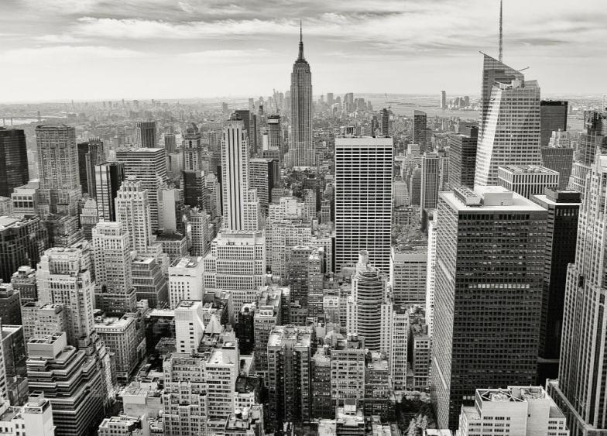

PART 02
工作完成情况
标题文字添加
The user can demonstrate on a projector or computer, or presentation and make it film to be used in a wider fieldThe user can demonstrate on a projector or computer, or presentation and make The user can demonstrate on a projector or computer,
标题文字添加
标题文字添加
标题文字添加
The user can demonstrate on a projector or computer, or presentation and make it film to be used in a wider field
The user can demonstrate on a projector or computer, or presentation and make it film to be used in a wider field
The user can demonstrate on a projector or computer, or presentation and make it film to be used in a wider field

Slide 11

PART 02
工作完成情况
标题文字添加
标题文字添加
The user can demonstrate on a projector or computer, or presentation and make it film to be used in a wider field
The user can demonstrate on a projector or computer, or presentation and make it film to be used in a wider field
标题文字添加
标题文字添加
The user can demonstrate on a projector or computer, or presentation and make it film to be used in a wider field
The user can demonstrate on a projector or computer, or presentation and make it film to be used in a wider field
标题文字添加
标题文字添加
The user can demonstrate on a projector or computer, or presentation and make it film to be used in a wider field
The user can demonstrate on a projector or computer, or presentation and make it film to be used in a wider field

Slide 12
PART 02
工作完成情况
The user can demonstrate on a projector or computeror presentation
The user can demonstrate on a projector or computeror presentation
The user can demonstrate on a projector or computeror presentation
The user can demonstrate on a projector or computeror presentation
The user can demonstrate on a projector or computeror presentation
2015
2016
2017
2018
2019

Slide 13
PART 02
工作完成情况
key words
key words
标题文字添加
标题文字添加
The user can demonstrate on a projector or computer, or presentation and make it film to be used in a wider field
key words
The user can demonstrate on a projector or computer, or presentation and make it film to be used in a wider field
key words
标题文字添加
标题文字添加
The user can demonstrate on a projector or computer, or presentation and make it film to be used in a wider field
2018
PROJECT
The user can demonstrate on a projector or computer, or presentation and make it film to be used in a wider field
PLAN

Slide 14
PART 02
工作完成情况
标题文字添加
标题文字添加
The user can demonstrate on a projector or computer, or presentation and make it film to be used in a wider fieldThe user can demonstrate on a projector or computer, or presentation and make it film to be used in a wider field
The user can demonstrate on a projector or computer, or presentation and make it film to be used in a wider fieldThe user can demonstrate on a projector or computer, or presentation and make it film to be used in a wider field
标题文字添加
标题文字添加
The user can demonstrate on a projector or computer, or presentation and make it film to be used in a wider fieldThe user can demonstrate on a projector or computer, or presentation and make it film to be used in a wider field
The user can demonstrate on a projector or computer, or presentation and make it film to be used in a wider fieldThe user can demonstrate on a projector or computer, or presentation and make it film to be used in a wider field

Slide 15
PART 03
工作存在不足
The user can demonstrate on a projector or computer or print the it into a film to be used in a wider field

Slide 16

PART 03
工作存在不足
标题文字添加
The user can demonstrate on a projector or computer, or presentation and make it film to be used in a wider fieldThe user can demonstrate on a projector or computer, or presentation
标题文字添加
标题文字添加
The user can demonstrate on a projector or computer, or presentation and make it film to be used in a wider field
The user can demonstrate on a projector or computer, or presentation and make it film to be used in a wider field

Slide 17
PART 03
工作存在不足
标题文字添加
标题文字添加
The user can demonstrate on a projector or computer, or presentation and make it film to be used in a wider field
The user can demonstrate on a projector or computer, or presentation and make it film to be used in a wider field
标题文字添加
标题文字添加
The user can demonstrate on a projector or computer, or presentation and make it film to be used in a wider field
The user can demonstrate on a projector or computer, or presentation and make it film to be used in a wider field

Slide 18
PART 03
工作存在不足
标题文字添加
标题文字添加
The user can demonstrate on a projector or computer, or presentation and make it film to be used in a wider field
The user can demonstrate on a projector or computer, or presentation and make it film to be used in a wider field
标题文字添加
标题文字添加
The user can demonstrate on a projector or computer, or presentation and make it film to be used in a wider field
The user can demonstrate on a projector or computer, or presentation and make it film to be used in a wider field

Slide 19
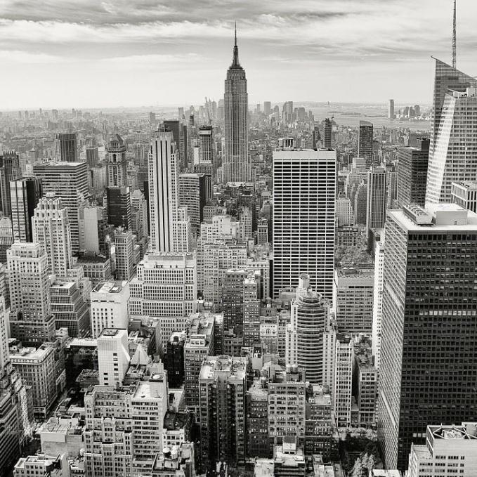
PART 03
工作存在不足
40%
25%
15%
10%
10%
标题文字添加
The user can demonstrate on a projector or computer, or presentation and make it film to be used in a wider field
标题文字添加
The user can demonstrate on a projector or computer, or presentation and make it film to be used in a wider field
标题文字添加
The user can demonstrate on a projector or computer, or presentation and make it film to be used in a wider field
标题文字添加
The user can demonstrate on a projector or computer, or presentation and make it film to be used in a wider field

Slide 20
PART 04
下步工作计划
The user can demonstrate on a projector or computer or print the it into a film to be used in a wider field

Slide 21



PART 04
下步工作计划
标题文字添加
The user can demonstrate on a projector or computer, or presentation and make it film to be used in a wider field
The user can demonstrate on a projector or computer, or presentation and make
标题文字添加
The user can demonstrate on a projector or computer, or presentation and make it film to be used in a wider field
The user can demonstrate on a projector or computer, or presentation and make

Slide 22
PART 04
下步工作计划
标题文字添加
标题文字添加
标题文字添加
标题文字添加
The user can demonstrate on a projector or computer, or presentation and make it film to be used in a wider field
The user can demonstrate on a projector or computer, or presentation and make it film to be used in a wider field
The user can demonstrate on a projector or computer, or presentation and make it film to be used in a wider field
The user can demonstrate on a projector or computer, or presentation and make it film to be used in a wider field

Slide 23
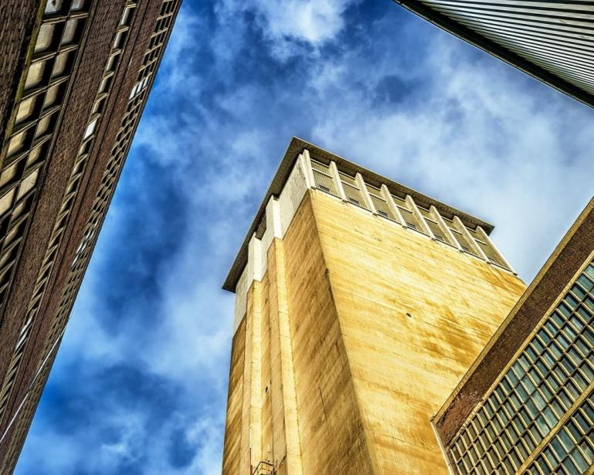
PART 04
下步工作计划
1
The user can demonstrate on a projector or computer, or presentation and make it film to be used in a wider field
2
The user can demonstrate on a projector or computer, or presentation and make it film to be used in a wider field
3
The user can demonstrate on a projector or computer, or presentation and make it film to be used in a wider field
4
The user can demonstrate on a projector or computer, or presentation and make it film to be used in a wider field
The user can demonstrate on a projector or computer, or presentation and make it film to be used in a wider field

Slide 24
PART 04
下步工作计划
标题文字添加
The user can demonstrate on a projector or computer, or presentation and make it film to be used in a wider field
The user can demonstrate on a projector or computer, or presentation and make it film to be used in a wider field
The user can demonstrate on a projector or computer, or presentation and make it film to be used in a wider field
The user can demonstrate on a projector or computer, or presentation and make it film to be used in a wider field

Slide 25
20XX
感谢您的观看
The user can demonstrate on a projector or computer, or print the presentation and make it into a film to be used in a wider field

