Slide 1
YOU LOGO
幼儿园小班说课稿ppt模板
The user can demonstrate on a projector or computer, or print the presentation and make it into a film to be used in a wider field The user can demonstrate

Slide 2
CONTENTS
The user can demonstrate on a projector or computer, or print the presentation and make it into a film to be used in a wider field The user can demonstrate
01
目标计划概要
02
目标计划程序
The user can demonstrate on a projector or computer
The user can demonstrate on a projector or computer
03
目标计划管控
04
管理总结考核
The user can demonstrate on a projector or computer
The user can demonstrate on a projector or computer

Slide 3
PART 01
目标计划概要
The user can demonstrate on a projector or computer, or print the presentation and make it into a film to be used in a wider field The user can demonstrate

Slide 4
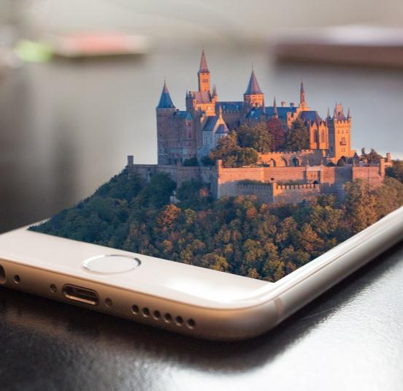
目标计划概要
The user can demonstrate on a projector or computer, or print the presentation and make it into a film to be used in a wider field The user can demonstrate
标题文字添加
The user can demonstrate on a projector or computer, or print the presentation and make it into a film to be used in a wider field. Using PowerPoint, The user can demonstrate on a projector or computer, or print the presentation and make it into a film to be used in a wider field. Using PowerPoint, The user can demonstrate on a projector or computer, or print the presentation and make it into a film to be used in a wider field. Using PowerPoint, The user can demonstrate on a projector or computer, or print the presentation and make it into a film to be used in a wider field. Using PowerPoint,
The user can demonstrate on a projector or computer, or print the presentation and make it into a film to be used in a wider field. Using PowerPoint, The user can demonstrate on a projector or computer, or print the presentation and make it into a film to be used in a wider field. Using PowerPoint, The user can demonstrate on a projector or computer, or print the presentation and make it into a film to be used in a wider field. Using PowerPoint, The user can demonstrate on a projector or computer, or print the presentation and make it into a film to be used in a wider field. Using PowerPoint,

Slide 5


目标计划概要
The user can demonstrate on a projector or computer, or print the presentation and make it into a film to be used in a wider field The user can demonstrate
The user can demonstrate on a projector or computer, or print the presentation and make it into a film to be used in a wider field. Using PowerPoint, The user can demonstrate on a projector or computer, or print the presentation and make it into a film to be used in a wider field. Using PowerPoint,
The user can demonstrate on a projector or computer, or print the presentation and make it into a film to be used in a wider field. Using PowerPoint, The user can demonstrate on a projector or computer, or print the presentation and make it into a film to be used in a wider field. Using PowerPoint,
标题文字添加
标题文字添加

Slide 6


目标计划概要
The user can demonstrate on a projector or computer, or print the presentation and make it into a film to be used in a wider field The user can demonstrate
标题文字添加
The user can demonstrate on a projector or computer, or print the presentation and make it into a film to be used in a wider field. Using PowerPoint,
The user can demonstrate on a projector or computer, or print the presentation and make it into a film to be used in a wider field. Using PowerPoint,
The user can demonstrate on a projector or computer, or print the presentation and make it into a film to be used in a wider field. Using PowerPoint,
The user can demonstrate on a projector or computer, or print the presentation and make it into a film to be used in a wider field. Using PowerPoint,

Slide 7

目标计划概要
The user can demonstrate on a projector or computer, or print the presentation and make it into a film to be used in a wider field The user can demonstrate
标题文字添加
The user can demonstrate on a projector or computer, or print the presentation and make it into a film to be used
标题文字添加
The user can demonstrate on a projector or computer, or print the presentation and make it into a film to be used
标题文字添加
The user can demonstrate on a projector or computer, or print the presentation and make it into a film to be used
标题文字添加
The user can demonstrate on a projector or computer, or print the presentation and make it into a film to be used

Slide 8
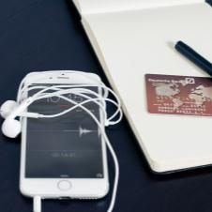
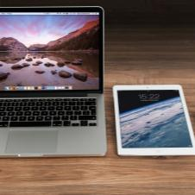
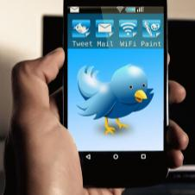





目标计划概要
The user can demonstrate on a projector or computer, or print the presentation and make it into a film to be used in a wider field The user can demonstrate
标题文字添加
标题文字添加
标题文字添加
标题文字添加
The user can demonstrate on a projector or computer
The user can demonstrate on a projector or computer
The user can demonstrate on a projector or computer
The user can demonstrate on a projector or computer
标题文字添加
标题文字添加
标题文字添加
标题文字添加
The user can demonstrate on a projector or computer
The user can demonstrate on a projector or computer
The user can demonstrate on a projector or computer
The user can demonstrate on a projector or computer

Slide 9
PART 02
目标计划程序
The user can demonstrate on a projector or computer, or print the presentation and make it into a film to be used in a wider field The user can demonstrate

Slide 10
目标计划程序
The user can demonstrate on a projector or computer, or print the presentation and make it into a film to be used in a wider field The user can demonstrate
标题文字添加
The user can demonstrate on a projector or computer, or print the presentation and make it into a film to be used in a wider field. Using PowerPoint, The user can demonstrate on a projector or computer, or print the presentation and make it into a film to be used in a wider field. Using PowerPoint, The user can demonstrate on a projector or computer, or print the presentation and make it into a film to be used in a wider field. Using PowerPoint, The user can demonstrate on a projector or computer, or print the presentation and make it into a film to be used in a wider field. Using PowerPoint,
标题文字添加
标题文字添加
标题文字添加
标题文字添加
标题文字添加
标题文字添加
标题文字添加
标题文字添加
标题文字添加
标题文字添加

Slide 11
目标计划程序
The user can demonstrate on a projector or computer, or print the presentation and make it into a film to be used in a wider field The user can demonstrate
The user can demonstrate on a projector or computer, or print the presentation and make it into a film to be used in a wider field. Using PowerPoint, The user can demonstrate on a projector or computer, or print the presentation and make it into a film to be used in a wider field. Using PowerPoint, The user can demonstrate on a projector or computer, or print the presentation and make it into a film to be used in a wider field. Using PowerPoint, The user can demonstrate on a projector or computer, or print the presentation

Slide 12



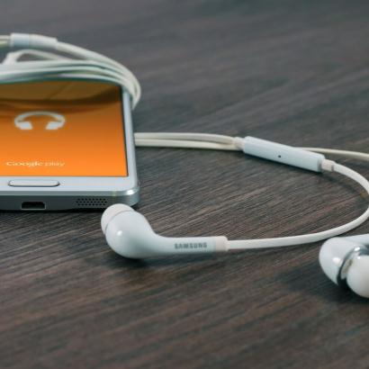
目标计划程序
The user can demonstrate on a projector or computer, or print the presentation and make it into a film to be used in a wider field The user can demonstrate
标题文字添加
标题文字添加
标题文字添加
标题文字添加
The user can demonstrate on a projector or computer, or print the presentation and make it into a film to be used in a wider field. Using PowerPoint,
The user can demonstrate on a projector or computer, or print the presentation and make it into a film to be used in a wider field. Using PowerPoint,
The user can demonstrate on a projector or computer, or print the presentation and make it into a film to be used in a wider field. Using PowerPoint,
The user can demonstrate on a projector or computer, or print the presentation and make it into a film to be used in a wider field. Using PowerPoint,

Slide 13
目标计划程序
The user can demonstrate on a projector or computer, or print the presentation and make it into a film to be used in a wider field The user can demonstrate
标题文字添加
标题文字添加
标题文字添加
The user can demonstrate on a projector or computer
The user can demonstrate on a projector or computer
The user can demonstrate on a projector or computer
标题文字添加
标题文字添加
标题文字添加
The user can demonstrate on a projector or computer
The user can demonstrate on a projector or computer
The user can demonstrate on a projector or computer
The user can demonstrate on a projector or computer, or print the presentation and make it into a film to be used in a wider field. Using PowerPoint, The user can demonstrate on a projector or computer, or print the presentation and make it into a film to be used in a wider field. Using PowerPoint, The user can demonstrate on a projector or computer, or print the presentation and make it into a film to be used in a wider field. Using PowerPoint, The user can demonstrate on a projector or computer, or print the presentation and make it into a film to be used in a wider field. Using PowerPoint,

Slide 14

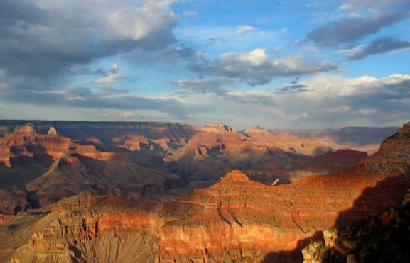

目标计划程序
The user can demonstrate on a projector or computer, or print the presentation and make it into a film to be used in a wider field The user can demonstrate
标题文字添加
标题文字添加
标题文字添加
The user can demonstrate on a projector or computer, or print the presentation and make it into a film to be used in a wider field. Using PowerPoint,
The user can demonstrate on a projector or computer, or print the presentation and make it into a film to be used in a wider field. Using PowerPoint,
The user can demonstrate on a projector or computer, or print the presentation and make it into a film to be used in a wider field. Using PowerPoint,

Slide 15
PART 03
目标计划管控
The user can demonstrate on a projector or computer, or print the presentation and make it into a film to be used in a wider field The user can demonstrate

Slide 16

目标计划管控
The user can demonstrate on a projector or computer, or print the presentation and make it into a film to be used in a wider field The user can demonstrate
标题文字添加
The user can demonstrate on a projector or computer, or print the presentation and make it into a film to be used in a wider field. Using PowerPoint, The user can demonstrate on a projector or computer, or print the presentation and make it into a film to be used in a wider field. Using PowerPoint,
标题文字添加
74%
标题文字添加
标题文字添加
68%
The user can demonstrate on a projector or computer, or print the presentation and make it into a film to be used in a wider field. Using PowerPoint,
标题文字添加
86%

Slide 17
目标计划管控
The user can demonstrate on a projector or computer, or print the presentation and make it into a film to be used in a wider field The user can demonstrate
标题文字添加
标题文字添加
标题文字添加
The user can demonstrate on a projector or computer, or print the presentation and make it into a film to be used in a wider field. Using PowerPoint,
The user can demonstrate on a projector or computer, or print the presentation and make it into a film to be used in a wider field. Using PowerPoint,
The user can demonstrate on a projector or computer, or print the presentation and make it into a film to be used in a wider field. Using PowerPoint,

Slide 18


目标计划管控
The user can demonstrate on a projector or computer, or print the presentation and make it into a film to be used in a wider field The user can demonstrate
标题文字添加
The user can demonstrate on a projector or computer, or print the presentation and make it into a film to be used in a wider field. Using PowerPoint,
The user can demonstrate on a projector or computer, or print the presentation and make it into a film to be used in a wider field. Using PowerPoint, The user can demonstrate on a projector or computer, or print the presentation and make it into a film to be used in a wider field. Using PowerPoint, The user can demonstrate on a projector or computer, or print the presentation and make it into a film to be used in a wider field. Using PowerPoint, The user can demonstrate on a projector or computer, or print the presentation and make it into a film to be used in a wider field. Using PowerPoint,

Slide 19



目标计划管控
The user can demonstrate on a projector or computer, or print the presentation and make it into a film to be used in a wider field The user can demonstrate
标题文字
添加
The user can demonstrate on a projector or computer, or print the presentation and make it into a film to be used in a wider field. Using PowerPoint, The user can demonstrate on a projector or computer, or print the presentation and make it into a film to be used in a wider field. Using PowerPoint,
标题文字
添加
The user can demonstrate on a projector or computer, or print the presentation and make it into a film to be used in a wider field. Using PowerPoint, The user can demonstrate on a projector or computer, or print the presentation and make it into a film to be used in a wider field. Using PowerPoint,
The user can demonstrate on a projector or computer, or print the presentation and make it into a film to be used in a wider field. Using PowerPoint, The user can demonstrate on a projector or computer, or print the presentation and make it into a film to be used in a wider field. Using PowerPoint,
标题文字
添加

Slide 20
PART 04
管理总结考核
The user can demonstrate on a projector or computer, or print the presentation and make it into a film to be used in a wider field The user can demonstrate

Slide 21
管理总结考核
The user can demonstrate on a projector or computer, or print the presentation and make it into a film to be used in a wider field The user can demonstrate
$562
$859
$478
$268
标题文字添加
标题文字添加
标题文字添加
标题文字添加
The user can demonstrate on a projector or computer, or print the presentation and make it into a film to be used in a wider field. Using PowerPoint,
The user can demonstrate on a projector or computer, or print the presentation and make it into a film to be used in a wider field. Using PowerPoint,
The user can demonstrate on a projector or computer, or print the presentation and make it into a film to be used in a wider field. Using PowerPoint,
The user can demonstrate on a projector or computer, or print the presentation and make it into a film to be used in a wider field. Using PowerPoint,

Slide 22
管理总结考核
The user can demonstrate on a projector or computer, or print the presentation and make it into a film to be used in a wider field The user can demonstrate
80%
77%
76%
70%
62%
50%
36%
文字添加
文字添加
文字添加
文字添加
文字添加
文字添加
文字添加
The user can demonstrate on a projector or computer, or print the presentation and make it into a film to be used in a wider field. Using PowerPoint, The user can demonstrate on a projector or computer, or print the presentation and make it into a film to be used in a wider field. Using PowerPoint, The user can demonstrate on a projector or computer, or print the presentation and make it into a film to be used in a wider field. Using PowerPoint, The user can demonstrate on a projector or computer, or print the presentation

Slide 23
管理总结考核
The user can demonstrate on a projector or computer, or print the presentation and make it into a film to be used in a wider field The user can demonstrate
标题文字添加
标题文字添加
标题文字添加
标题文字添加
The user can demonstrate on a projector or computer, or print the presentation and make it into a film to be used in a wider field. Using PowerPoint,
The user can demonstrate on a projector or computer, or print the presentation and make it into a film to be used in a wider field. Using PowerPoint,
The user can demonstrate on a projector or computer, or print the presentation and make it into a film to be used in a wider field. Using PowerPoint,
The user can demonstrate on a projector or computer, or print the presentation and make it into a film to be used in a wider field. Using PowerPoint,

Slide 24
管理总结考核
The user can demonstrate on a projector or computer, or print the presentation and make it into a film to be used in a wider field The user can demonstrate
标题文字添加
标题文字添加
标题文字添加
The user can demonstrate on a projector or computer
The user can demonstrate on a projector or computer
The user can demonstrate on a projector or computer
标题文字添加
标题文字添加
The user can demonstrate on a projector or computer
The user can demonstrate on a projector or computer

Slide 25
YOU LOGO
感谢您的观看
The user can demonstrate on a projector or computer, or print the presentation and make it into a film to be used in a wider field The user can demonstrate

