Slide 1

安全管理课程总结ppt模板
Entrepreneurial activities
Entrepreneurial activities differ substantially depending on the type of organization.

Slide 2

ABOUT US
Entrepreneurial activities differ substantially depending on the type of organization
OUR VALUES
Entrepreneurial activities differ substantially depending on the type of organization
WITH FEATURES
Entrepreneurial activities differ substantially depending on the type of organization
MOCKUP
Entrepreneurial activities differ substantially depending on the type of organization

Slide 3

ABOUT US
Entrepreneurial activities differ type depending on the type of organization
Entrepreneurial activities differ substantially depending on the type of organization.

Slide 4

YOUR TITLE
A company is an association or collection of individuals, whether natural persons, legal persons, or a mixture of both. Company members share a common purpose and unite in order to focus their various talents and organize their collectively available skills or resources to achieve specific, declared goals
OUR LATEST WORKS
A company is an association or collection of individuals, whether natural persons, legal persons, or a mixture of both. Company members share a common purpose and unite in order to focus their various talents.

Slide 5

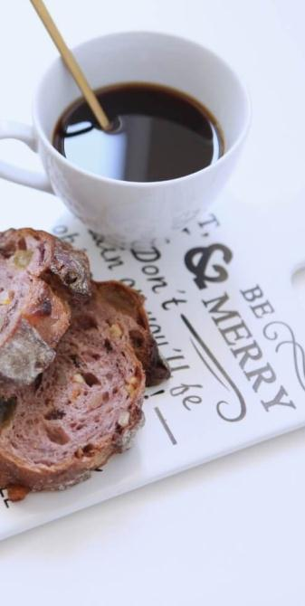
15%
Company members share a common purpose and unite in order to focus their various talents and organize their
FIRST TITLE Entrepreneurial activities differ substantially depending on the.
SECOND TITLE Entrepreneurial activities differ substantially depending on the.

Slide 6

SHORT
Entrepreneurial activities differ substantially depending on the type of organization and creativity involved.
LONG TERM
Entrepreneurial activities differ substantially depending on the type of organization and creativity involved.
LONG TERM
SOMETHING
Entrepreneurial activities differ substantially depending on the type of organization and creativity involved.
Entrepreneurial activities differ substantially depending on the type of organization and creativity involved.. Entrepreneurial activities differ substantially depending on the type of organization and creativity involved..

Slide 7




YOUR TITLE
A company is an association or collection of individuals, whether natural persons, legal persons, or a mixture of both. Company members share a common purpose and unite in order to focus their various talents and organize their collectively available skills or resources to achieve specific, declared goals

Slide 8

OUR VALUES
Entrepreneurial activities differ type depending on the type of organization
Entrepreneurial activities differ substantially depending on the type of organization.

Slide 9


OUR LATEST WORKS
A company is an association or collection of individuals, whether natural persons, legal persons, or a mixture of both. Company members share a common purpose and unite in order to focus their various talents.
GOOD BEST
A company is an association or collection of individuals, whether natural persons, legal persons, or a mixture of both. Company members share a common purpose and unite in order to focus their various talents.

Slide 10

OUR LATEST WORKS
A company is an association or collection of individuals, whether natural persons, legal persons, or a mixture of both. Company members share a common purpose and unite in order to focus their various talents.
Entrepreneurial activities differ substantially depending on the type of organization and creativity involved. Entrepreneurship ranges in scale from solo, part-time projects to large-scale.

Slide 11


OUR LATEST
A company is an association or collection of individuals, whether natural persons, legal persons, or a mixture of both. Company members .
BEST FRIEDNT
A company is an association or collection of individuals, whether natural persons, legal persons, or a mixture of both. Company members .

Slide 12



OUR LATEST WORKS
A company is an association or collection of individuals, whether natural persons, legal persons, or a mixture of both. Company members share a common purpose and unite in order to focus their various talents.
A company is an association or collection of individuals, whether natural persons, legal persons, or a mixture of both. Company members share a common purpose and unite in order to focus their various talents and organize their collectively available skills or resources to achieve specific, declared goals

Slide 13

WITH FEATURES
Entrepreneurial activities differ type depending on the type of organization
Entrepreneurial activities differ substantially depending on the type of organization.

Slide 14

OUR LATEST WORKS
Entrepreneurial activities differ substantially depending on the type of organization and creativity involved. Entrepreneurship ranges in scale from solo, part-time projects to large-scale.

Slide 15


OUR LATEST WORKS
A company is an association or collection of individuals, whether natural persons, legal persons, or a mixture of both. Company members share a common purpose and unite in order to focus their various talents.
A company is an association or collection of individuals, whether natural persons, legal persons, or a mixture of both. Company members share a common purpose and unite in order to focus their various talents and organize their collectively available skills or resources to achieve specific, declared goals

Slide 16

YOUR TITLE
Entrepreneurial activities differ substantially depending on the type of organization and creativity involved. Entrepreneurship ranges in scale from solo, part-time projects to large-scale.
OUR LATEST WORKS
Entrepreneurial activities differ substantially depending on the type of organization and creativity involved. Entrepreneurship ranges in scale from solo, part-time projects to large-scale.

Slide 17


OUR LATEST WORKS
Entrepreneurial activities differ substantially depending on the type of organization and creativity involved. Entrepreneurship ranges in scale from solo, part-time projects to large-scale.
A company is an association or collection of individuals, whether natural persons, legal persons, or a mixture of both. Company members share a common purpose and unite in order to focus their various talents and organize

Slide 18

MOCKUP
Entrepreneurial activities differ type depending on the type of organization
Entrepreneurial activities differ substantially depending on the type of organization.

Slide 19


OUR LATEST WORKS
Entrepreneurial activities differ substantially depending on the type of organization and creativity involved. Entrepreneurship ranges in scale from solo, part-time projects to large-scale.
A company is an association or collection of individuals, whether natural persons, legal persons, or a mixture of both. Company members share a common purpose and unite in order to focus their various talents and organize

Slide 20


OUR LATEST WORKS
Entrepreneurial activities differ substantially depending on the type of organization and creativity involved. Entrepreneurship ranges in scale from solo, part-time projects to large-scale.
Entrepreneurial activities differ substantially depending on the type of organization and creativity involved. Entrepreneurship ranges in scale from solo, part-time projects to large-scale.

Slide 21



OUR LATEST WORKS
Entrepreneurial activities differ substantially depending on the type of organization and creativity involved. Entrepreneurship ranges in scale from solo, part-time projects to large-scale.
Entrepreneurial activities differ substantially depending on the type of organization and creativity involved.
Entrepreneurial activities differ substantially depending on the type of organization and creativity involved.

Slide 22


A company is an association or collection of individuals, whether natural persons, legal persons, or a mixture of both. Company members share a common purpose and unite in order to focus their various talents and organize their collectively available skills or resources to achieve specific, declared goals
OUR LATEST WORKS
Entrepreneurial activities differ substantially depending on the type of organization and creativity involved. Entrepreneurship ranges in scale from solo, part-time projects to large-scale.

Slide 23
THANK YOU
Entrepreneurial activities
Entrepreneurial activities differ substantially depending on the type of organization.

