Slide 1



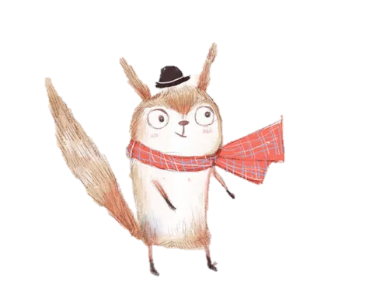
手绘动物卡通通用模板
I will do somebody a good turnJust for today I will try to live through this day only and not tackle my whole three ways. I will do somebody a good turnJust for today I
汇报人：XXX 时间：XX年XX月

Slide 2
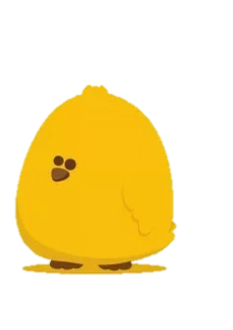
Just for today I will try to live through this day only and not tackle my whole life problem at once
目
录
Just for today I will try to live through this day only and not tackle my whole life problem at once
Just for today I will try to live through this day only and not tackle my whole life problem at once
Just for today I will try to live through this day only and not tackle my whole life problem at once

Slide 3

第 一 部 分
Just for today I will try to live through this day only and not tackle my whole. Just for today I will try to live through this day only and not tackle my whole.

Slide 4

输入文本内容
输入文本内容
I will do somebody a good turnJust for today I will try to live through this day only and not tackle my whole three ways. I will do somebody a good turnJust for today I will try to live through this day only and not tackle my whole three ways.
I will do somebody a good turnJust for today I will try to live through this day only and not tackle my whole three ways. I will do somebody a good turnJust for today I will try to live through this day only and not tackle my whole three ways.

Slide 5
01
02
03
输入文本内容
输入文本内容
输入文本内容
exercise my soul in three I will do at least two things I don‘t want to do
exercise my soul in three I will do at least two things I don‘t want to do
exercise my soul in three I will do at least two things I don‘t want to do

Slide 6

输入文本内容
I will do somebody a good turnJust for today I will try to live through this day only and not tackle my whole three ways.
输入文本内容
I will do somebody a good turnJust for today I will try to live through this day only and not tackle my whole three ways.
输入文本内容
I will do somebody a good turnJust for today I will try to live through this day only and not tackle my whole three ways.

Slide 7
输入文本内容
I will do somebody a good turnJust for today I will try to live through this day only and not tackle my whole three ways. I will do somebody a good turnJust for today I will try to live through this day only and not tackle my whole three ways.
输入文本内容
I will do somebody a good turnJust for today I will try to live through this day only and not tackle my whole three ways. I will do somebody a good turnJust for today I will try to live through this day only and not tackle my whole three ways.

Slide 8
第 二 部 分
Just for today I will try to live through this day only and not tackle my whole. Just for today I will try to live through this day only and not tackle my whole.

Slide 9

输入文本内容
01
I will do somebody a good turnJust for today I will try to live through this day only and not tackle my whole three ways.
输入文本内容
02
I will do somebody a good turnJust for today I will try to live through this day only and not tackle my whole three ways.

Slide 10
输入文本内容
I will do somebody a good turnJust for today I will try to live through this day only and not tackle my whole three ways.
输入文本内容
输入文本内容
I will do somebody a good turnJust for today I will try to live through this day only and not tackle my whole three ways.
I will do somebody a good turnJust for today I will try to live through this day only and not tackle my whole three ways.

Slide 11
输入文本内容
I will do somebody a good turnJust for today I will try to live through this day only and not tackle my whole three ways. I will do somebody a good turnJust for today I will try to live through this day only and not tackle my whole three ways.
输入文本内容
I will do somebody a good turnJust for today I will try to live through this day only and not tackle my whole three ways. I will do somebody a good turnJust for today I will try to live through this day only and not tackle my whole three ways.

Slide 12
第 三 部 分
Just for today I will try to live through this day only and not tackle my whole. Just for today I will try to live through this day only and not tackle my whole.

Slide 13
输入文本内容
I will do somebody a good turnJust for today I will try to live through this day only and not tackle my whole three ways.
输入文本内容
I will do somebody a good turnJust for today I will try to live through this day only and not tackle my whole three ways.

Slide 14
0 1
Just for today I will try to live through this day only and not tackle my whole life problem at once
0 2
Just for today I will try to live through this day only and not tackle my whole life problem at once
03
Just for today I will try to live through this day only and not tackle my whole life problem at once

Slide 15
第 四部 分
Just for today I will try to live through this day only and not tackle my whole. Just for today I will try to live through this day only and not tackle my whole.

Slide 16
输入文本内容
输入文本内容
Just for today I will try to live through this day only and not tackle my whole life problem at once. I can do for twelve hours that Just for today I will try to live through this day.
Just for today I will try to live through this day only and not tackle my whole life problem at once. I can do for twelve hours that Just for today I will try to live through this day.

Slide 17
1
点 击 即 可 添 加 标 题
2
点 击 即 可 添 加 标 题
Just for today I will try to live through this day only and not tackle my whole
Just for today I will try to live through this day only and not tackle my whole
3
点 击 即 可 添 加 标 题
4
点 击 即 可 添 加 标 题
Just for today I will try to live through this day only and not tackle my whole
Just for today I will try to live through this day only and not tackle my whole

Slide 18
感 谢 您 的 观 看
I will do somebody a good turnJust for today I will try to live through this day only and not tackle my whole three ways. I will do somebody a good turnJust for today I

